Slide 1
ClimbCode

Slide 2
Our Path Today
The Workgroup
MVP & Idea
Work Methodology
Business and costs
2

Slide 3
The Workgroup

Slide 4
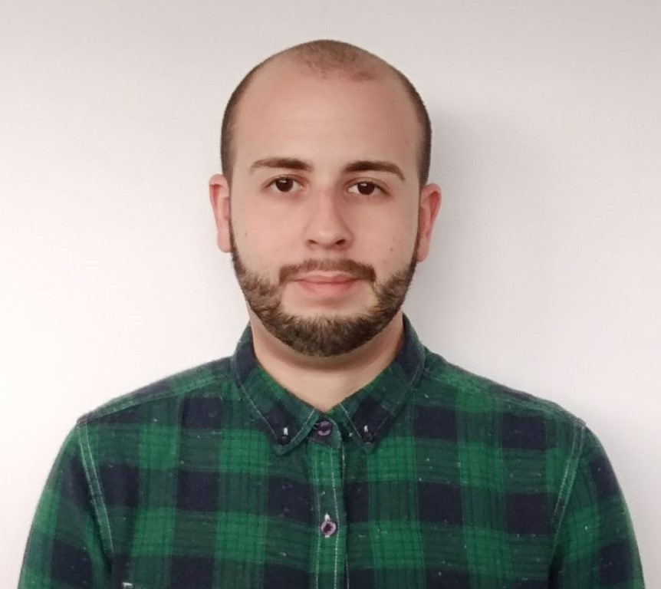

The Workgroup
Miguel Ángel Baños Carretón: Software Engineer
Álvaro Domínguez Núñez: Business Manager
4

Slide 5
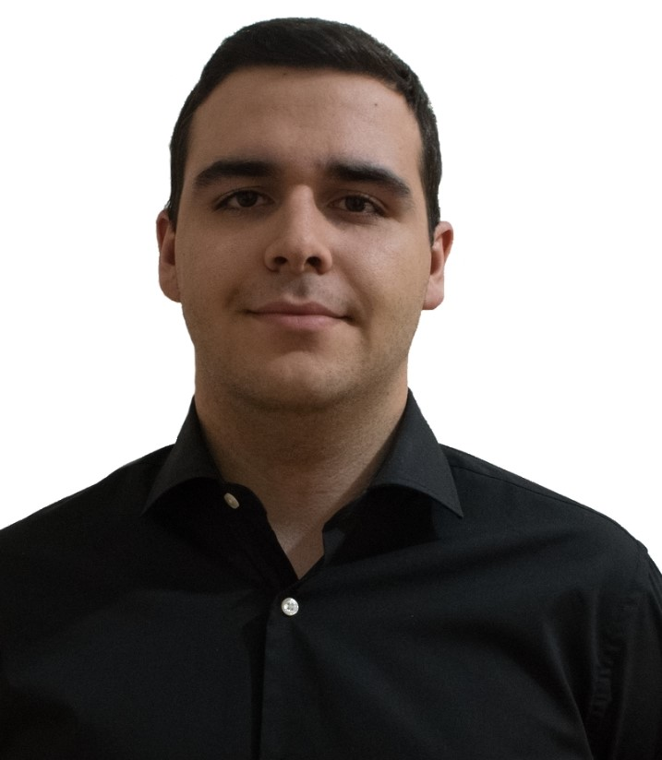
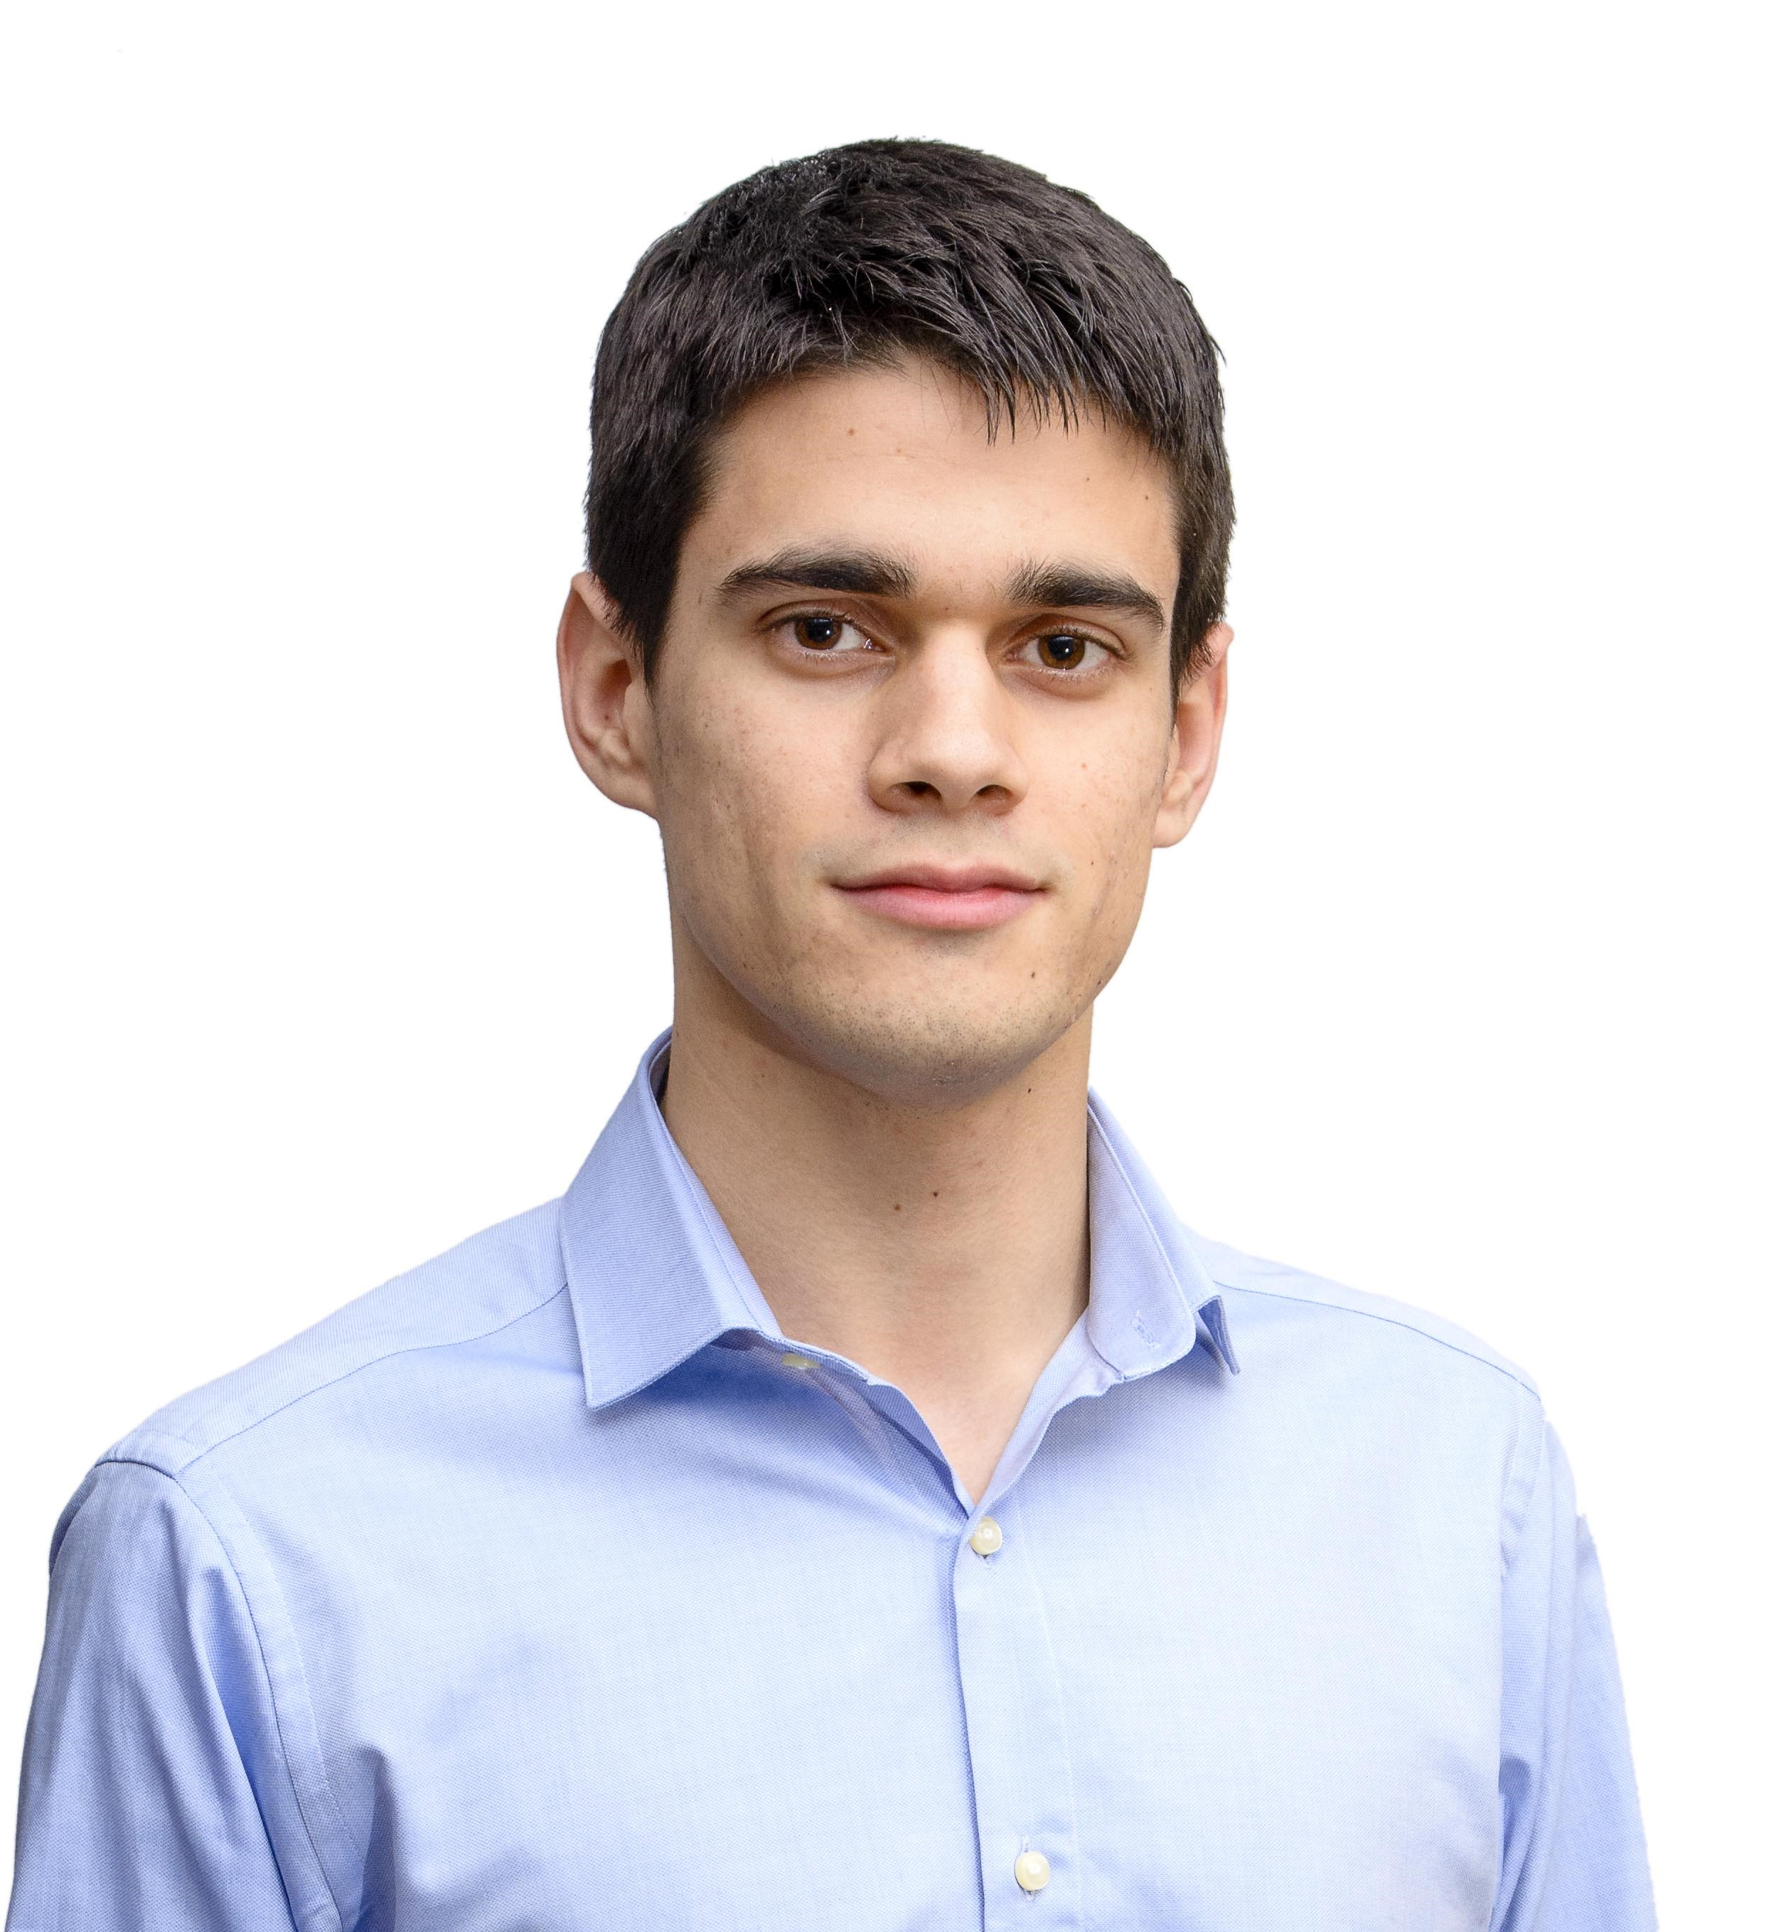
The Workgroup
Andrés Fernández Alés: Software Engineer
Alejandro Garrido Resina: Software Engineer
5

Slide 6
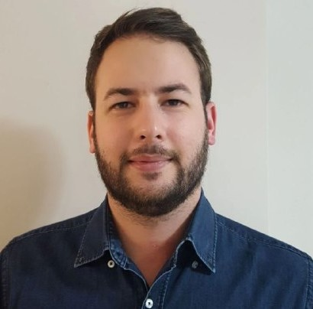
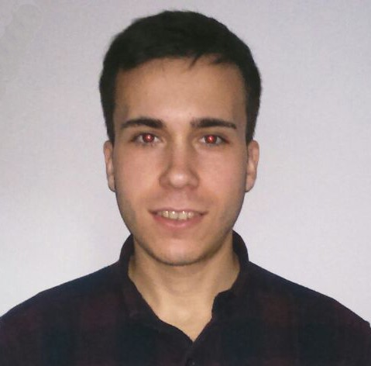
The Workgroup
Alejandro Román Rodríguez:
Project Manager
Álvaro Sánchez López: Software Engineer
6

Slide 7
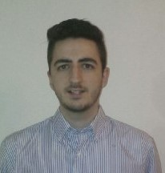

The Workgroup
Jesús Sosa Sánchez: Software Engineer
7

Slide 8
MVP & Idea

Slide 9

MVP & Idea
ClimbCode:
Platform for teachers and students
Help to other subjects
First contact with programming
Two in one!
9

Slide 10

MVP & Idea
Administrator:
Create new Schools
10

Slide 11

MVP & Idea
School:
Manage users and subjects
11

Slide 12


MVP & Idea
Teacher:
Put Documents and Exercises
12

Slide 13

MVP & Idea
Student:
Take Documents and Exercises
13

Slide 14

How?
14

Slide 15
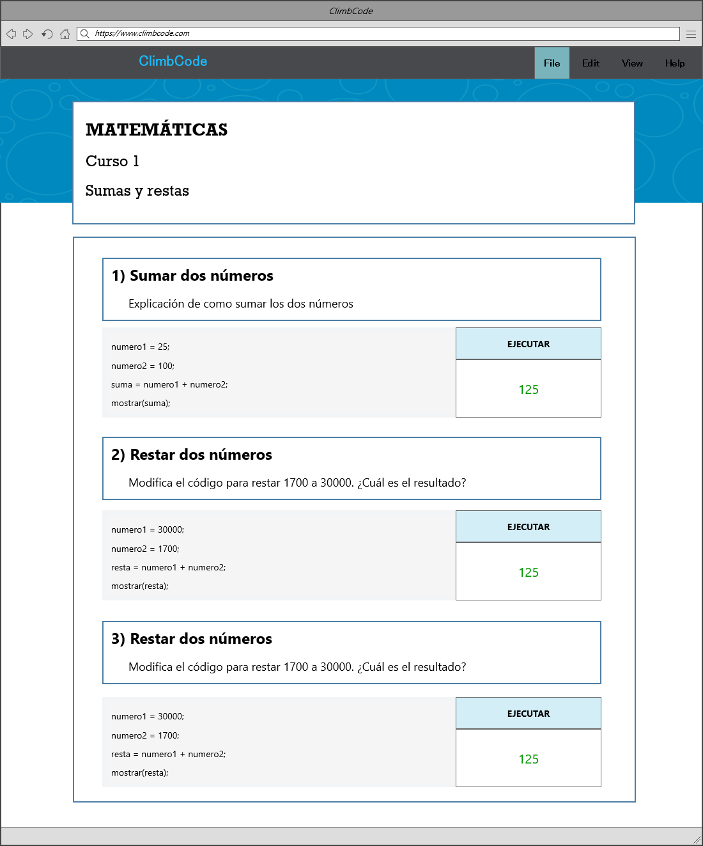
15

Slide 16
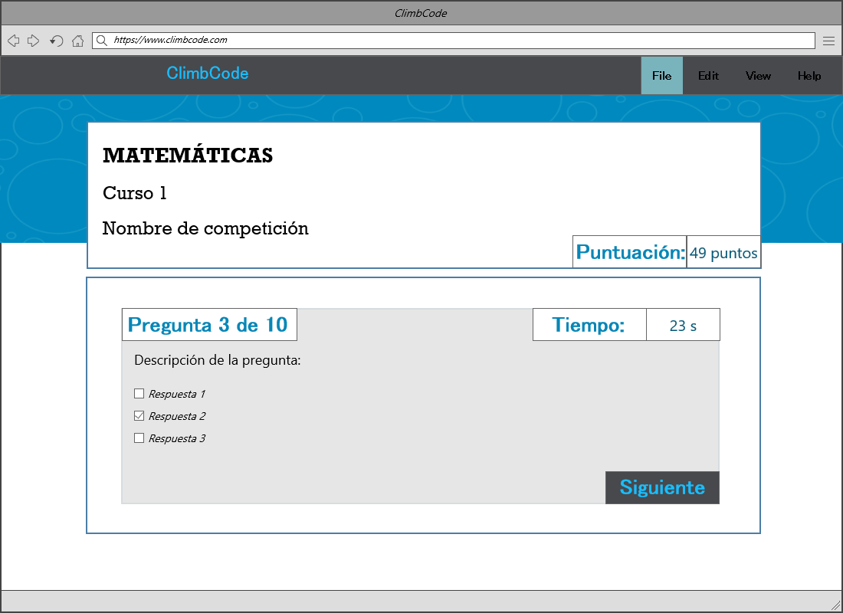
16

Slide 17
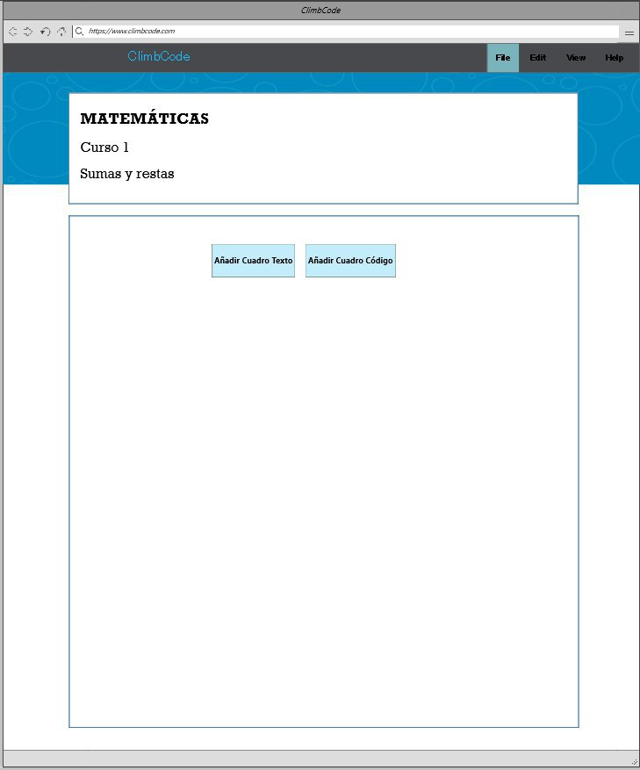
17

Slide 18
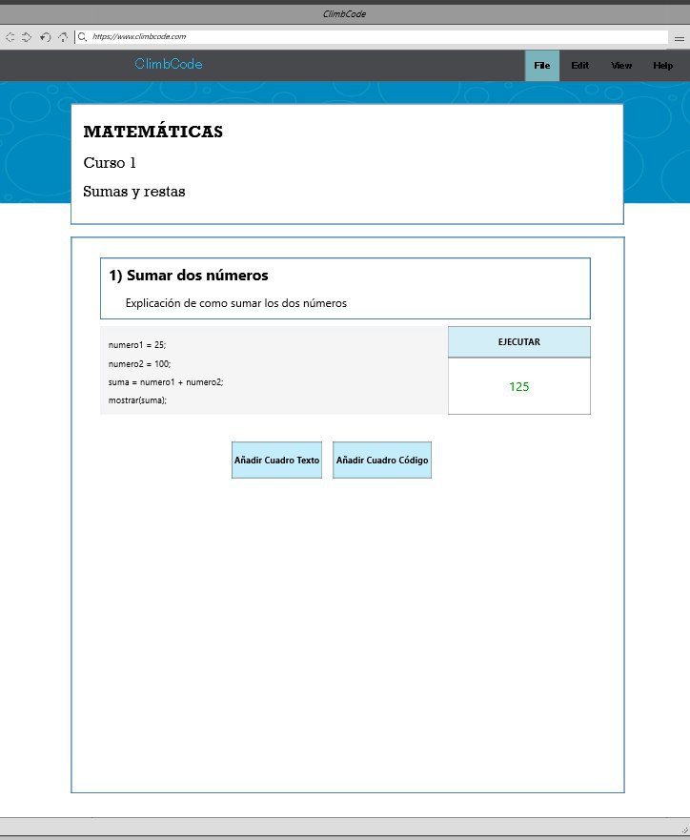
18

Slide 19


MVP & Idea
Strengths:
19

Slide 20


MVP & Idea
Weaknesses:
20

Slide 21


MVP & Idea
Oportunities:
21

Slide 22

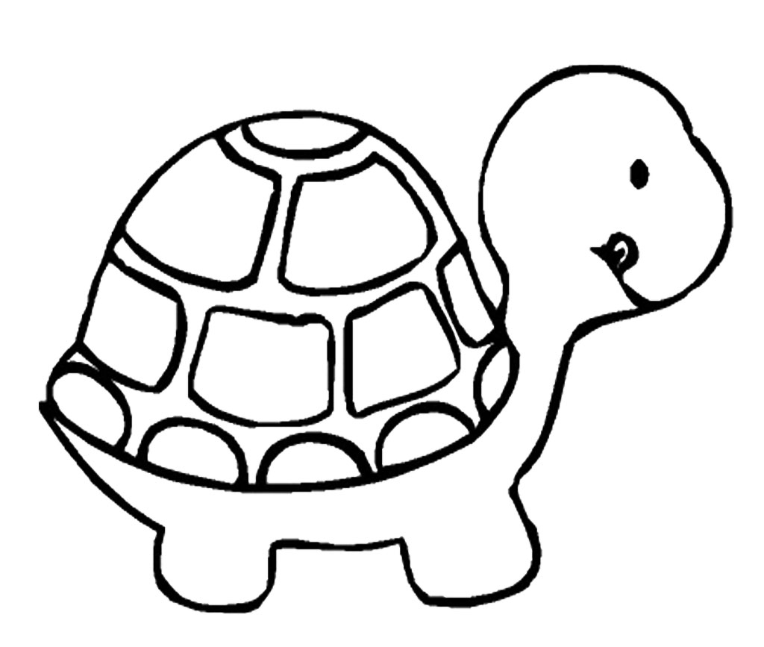
MVP & Idea
Threats:
22

Slide 23
Work Methodology

Slide 24

Work Methodology
SCRUM: Three Sprints.
24

Slide 25


Work Methodology
Sprint 1:
Week 1: CRUDs and Main Page
Week 2: Uploading documents
25

Slide 26

Work Methodology
Future Sprints:
26

Slide 27



Work Methodology
Technology:
27

Slide 28
Business and Costs

Slide 29

Education
29

Slide 30

Is it worth it?
30

Slide 31
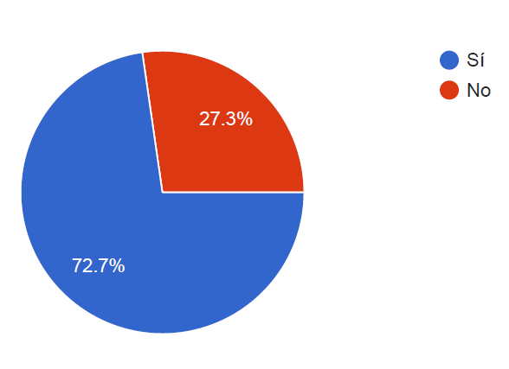
Business and Costs
From 88 people: Related to teaching
31

Slide 32
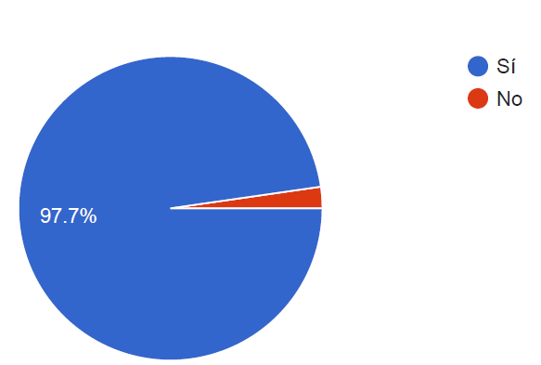
Business and Costs
From 88 people: Thoughts about programming
32

Slide 33
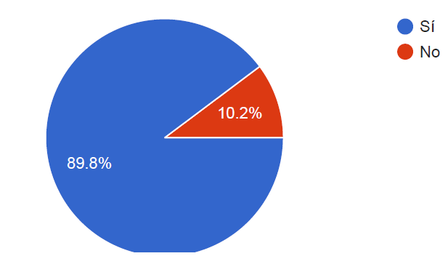
Business and Costs
From 88 people: Want a tool for programming at school
33

Slide 34
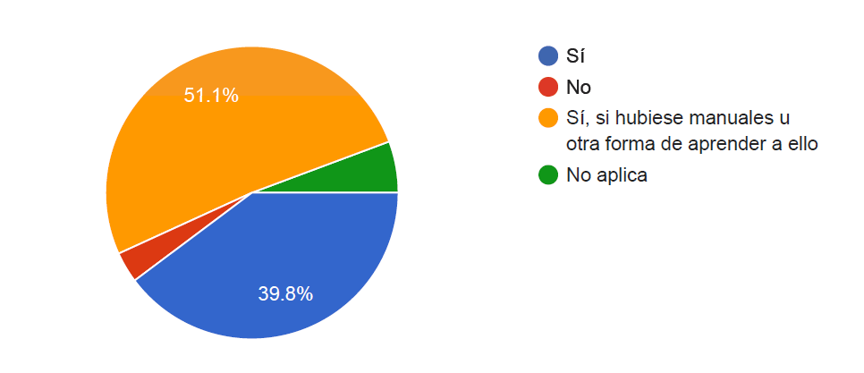
Business and Costs
From 88 people: Would use the tool
34

Slide 35
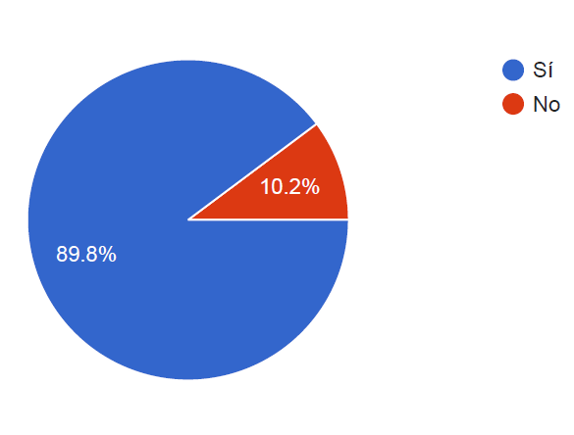
Business and Costs
From 88 people: Thoughts about students
35

Slide 36

How much?
36

Slide 37
Business and Costs
Direct Costs: 3721,4 €/m
Indirect Costs: 20,5 €/m
Amortizations: 816,62 €/m
37

Slide 38
Business and Costs
4540,52 €/m
22162,08 €
38

Slide 39

Business and Costs
Green
5 subjects
60 users
200€/y
Blue
15 subjects
200 users
550€/y
Yellow
25 subjects
500 users
700€/y
Red
40 subjects
800 users
1100€/y
39

Slide 40

THANKS!
You can find me at
alvdomnun@alum.us.es
40

